Slide 1
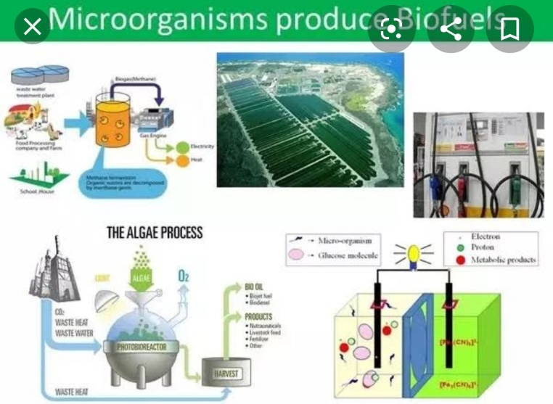
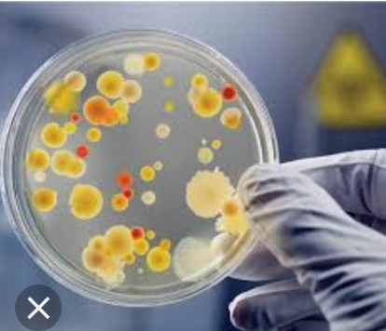
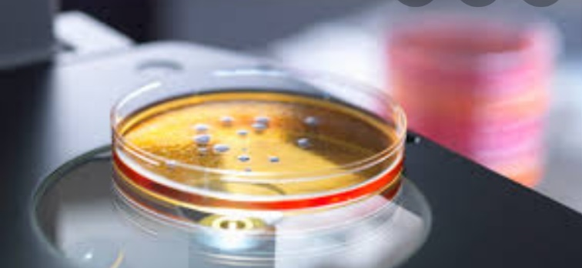
Microbiology in day today life Brijlal Biyani Science Collage, Amravati Aakanksha Kiranrao Balode
Microbiology is used in our daily life and plays an important role in it. Some of the main features of the microbiology which are used in our daily life are discussed here. Microbiology applied in everyday life, in food production, biodegradation, commercial product production, biotechnology and genetic production, biotechnology and genetic engineering.
Microbiology is the study of small living things that are too small to be visible with the naked eye. This living things can be seen with the use of a microscope only. These life forms are called microorganisms or microbes. Microorganisms include bacteria, archaea, viruses, protozoa, microscopic fungi and yeasts, and microscopic algae. Microbiology research encompasses all aspects of these microorganisms such as their behaviour, evolution, ecology, biochemistry, and physiology, along with the pathology of diseases that they cause. These microbes play crucial roles in nutrient cycling, biodegradation, climate change, food spoilage, the cause and control of disease., and biotechnology.
By Jennifer stearns, Michael Surette
There are many professions where knowing about microbes, either pathogenic or benign, is handy. There are also plenty of situations where applying a microbiology approach to a problem will get you out of a jam. Some are industries that employ microbiologists, and other are situations where a knowledge of microbiology is essential to getting the job done.

